Slide 1
Home Automation
Brian Curtis, Awa Ka, Dean Nelson, Colin Redmond

Slide 2


Light Switch With Android App
Switch light on and off mainly using the Android application, Bluetooth and Arduino Uno
Part Worked on by: Awa Ka

Slide 3
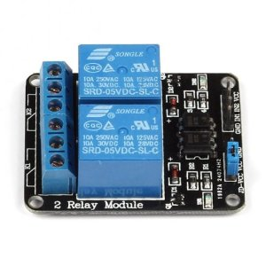
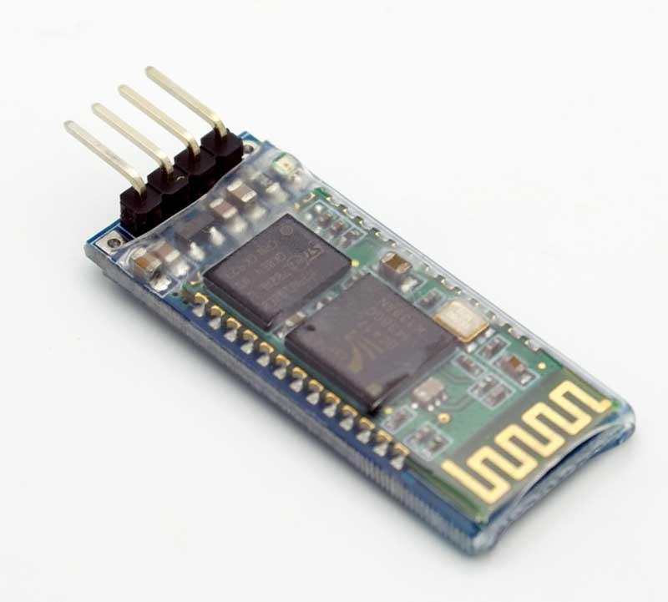
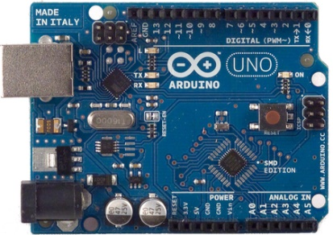
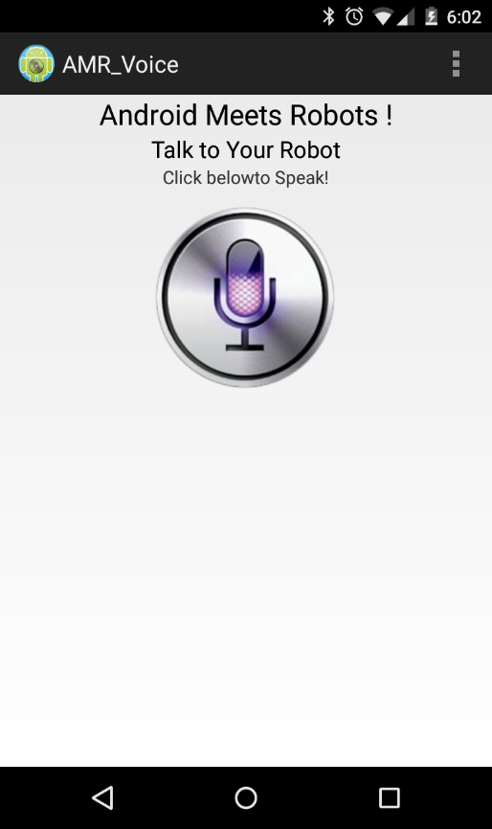
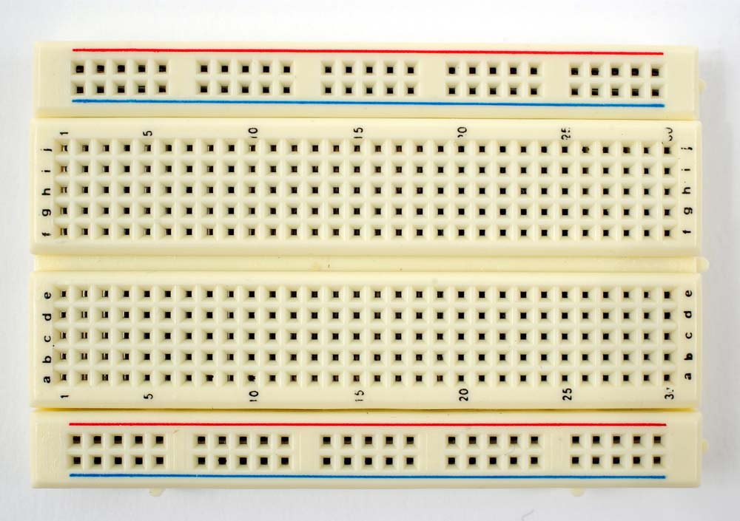
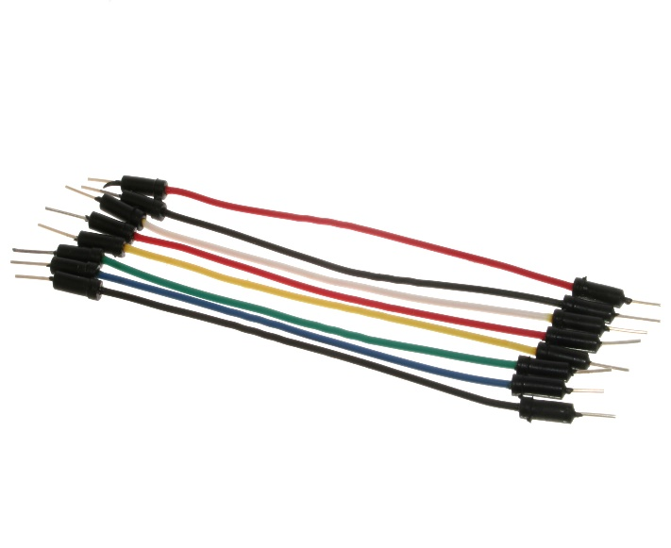
Parts Needed

Slide 4
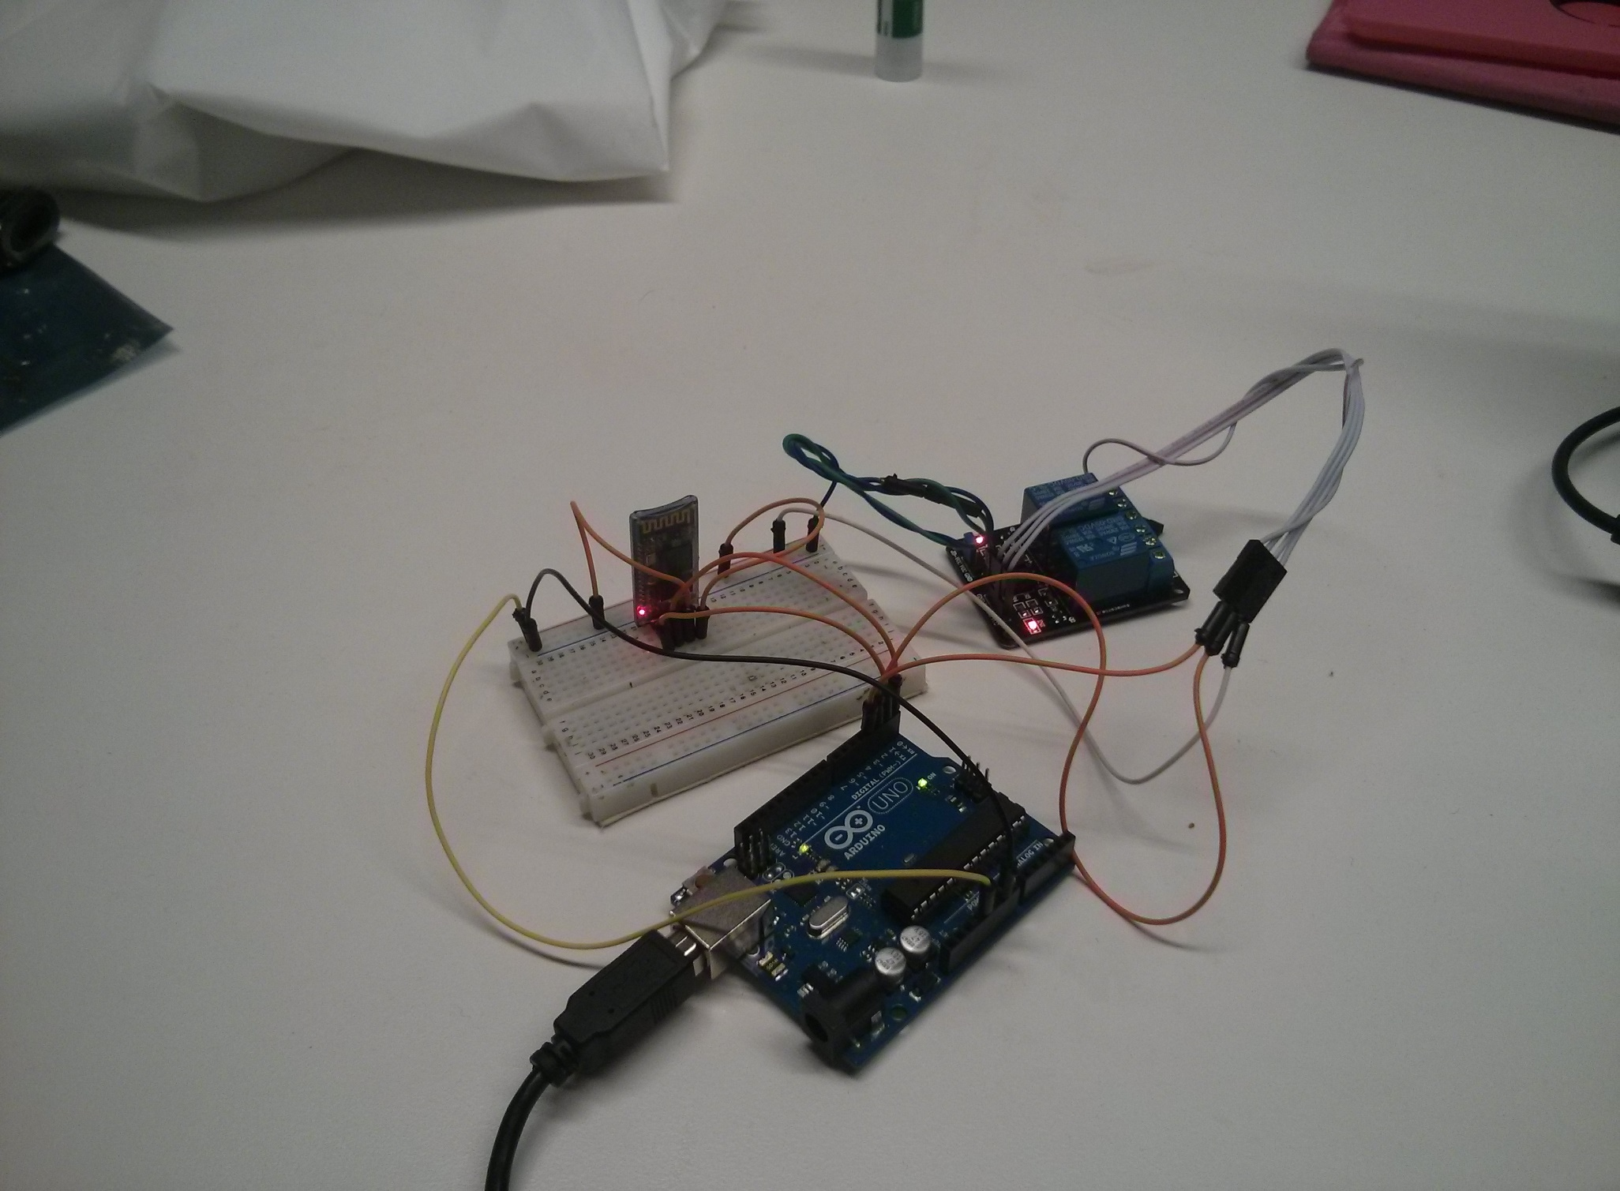

Slide 5
Laundry Machine Completion Sensor
Part worked on by: Brian Curtis

Slide 6
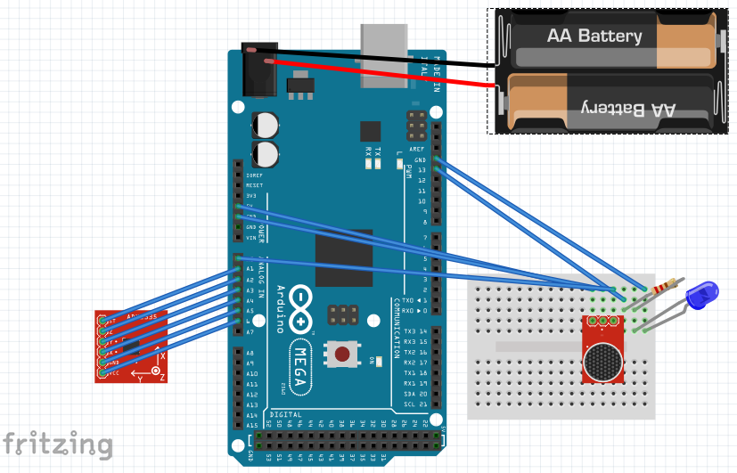

Slide 7
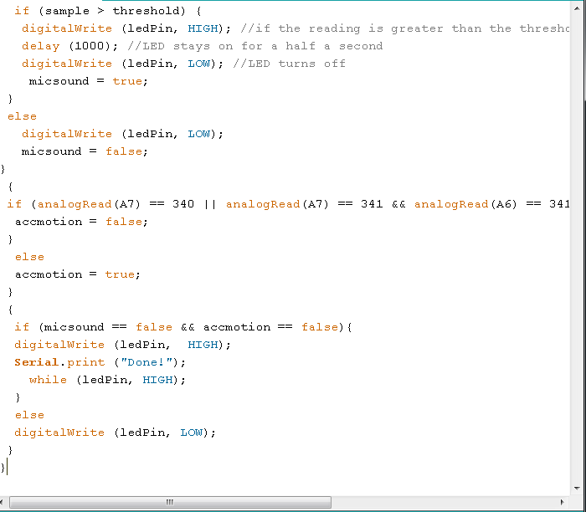
Code for microphone TRUE or FALSE
Code for accelerometer TRUE or FALSE
accelerometer “motionless” values
End phase if washing machine is determined finished.

Slide 8
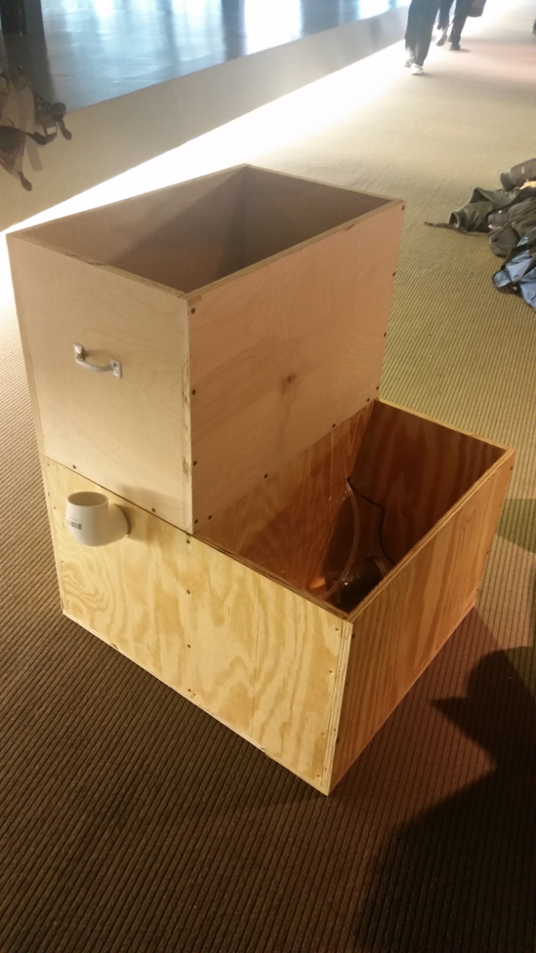
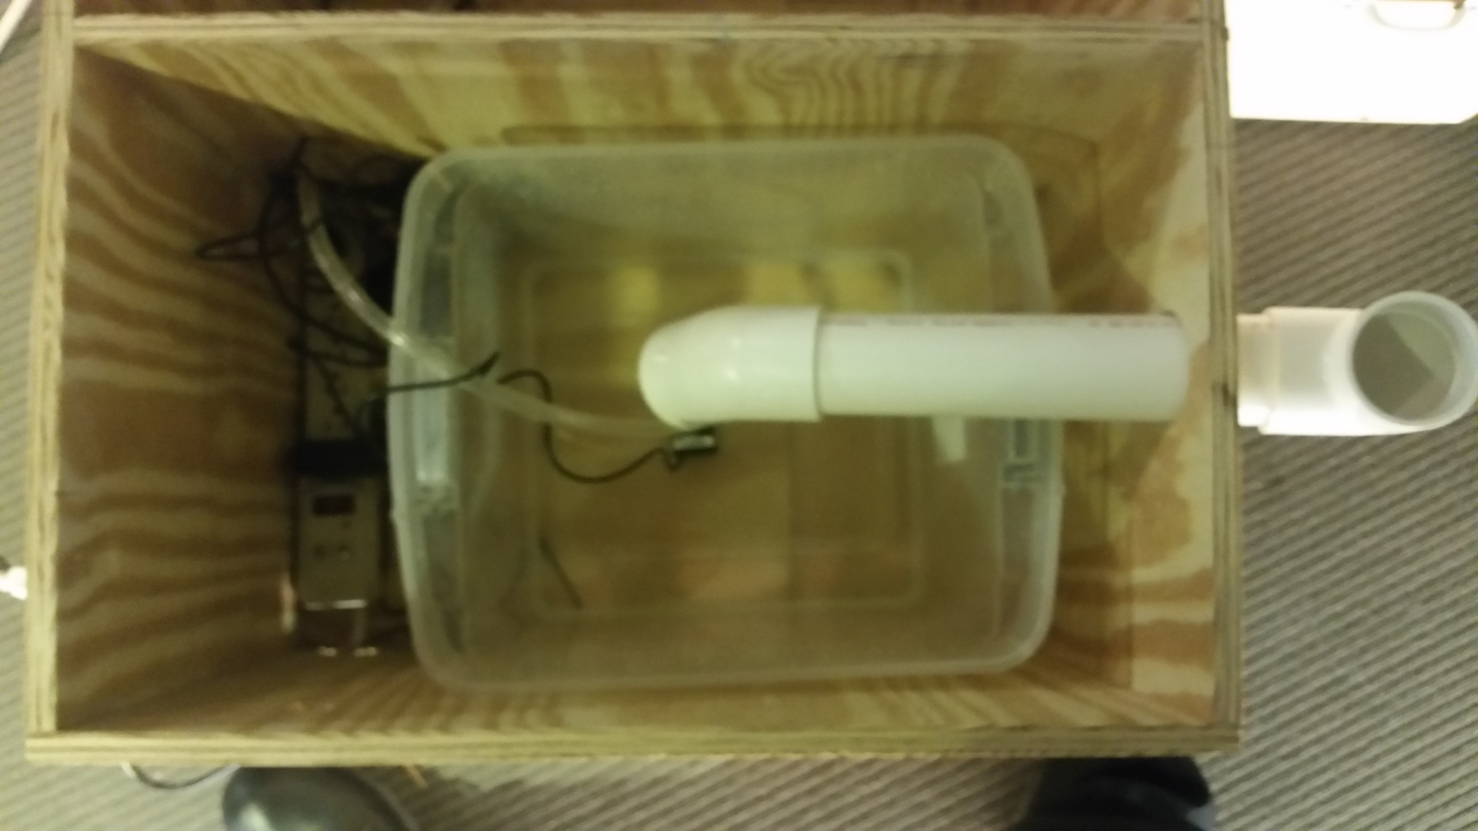
Automated Home Watering Station
Part Worked on by: Dean Nelson

Slide 9
Automated Home Watering Station
Gathers data from a soil humidity sensor
Intelligently decides if plant needs water
Turns the pump on if the plants need water.

Slide 10

OpenHab Home Automation Server
Automating sensors and devices around the house.
Part Worked on by: Colin Redmond

Slide 11
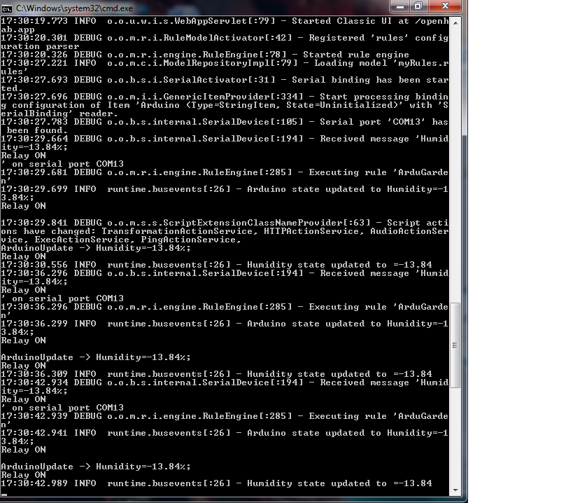
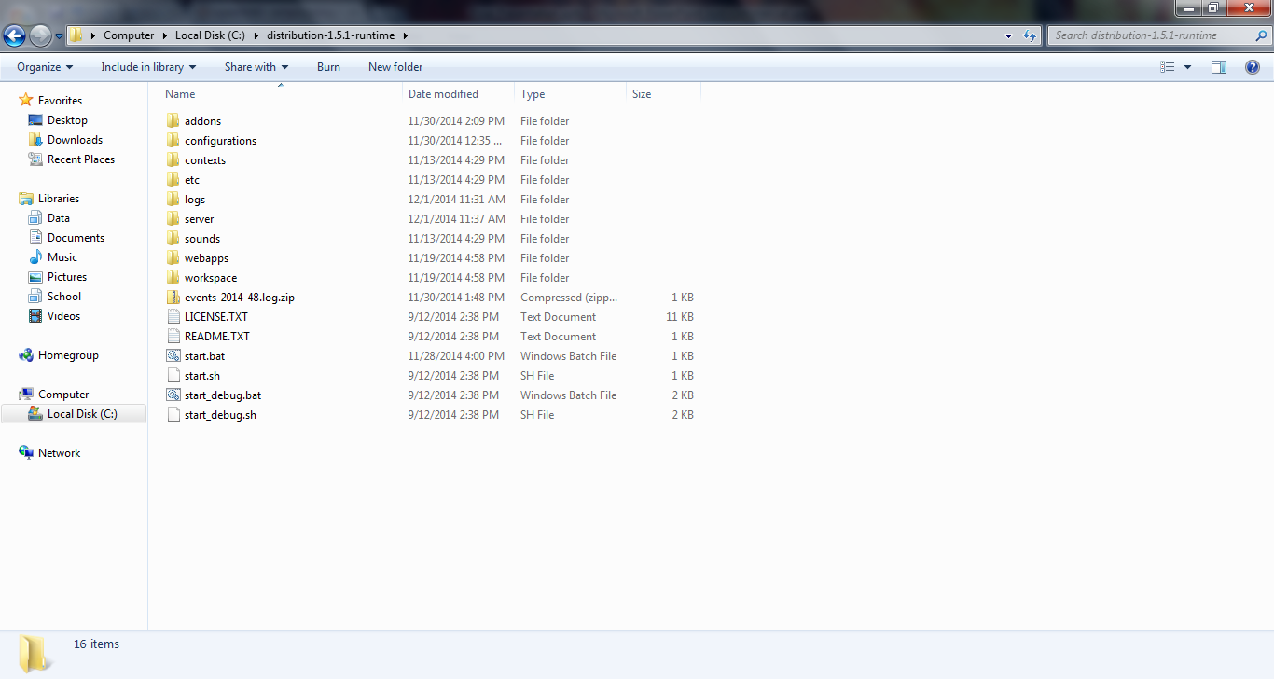
OpenHab is a java based, multi-platform server that automates various user-defined sensors and mechanisms .
OpenHab is versatile in that it supports many different kinds of technologies

Slide 12
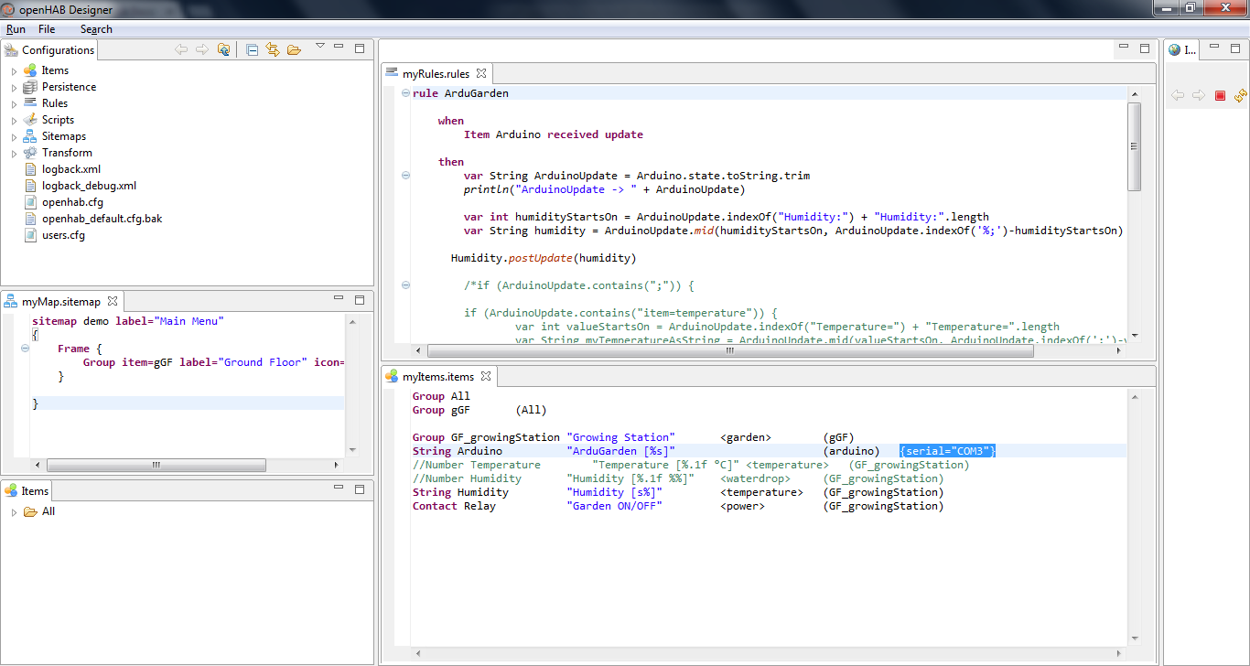
It accomplishes this by binding various services (plugins) to physical hardware, it then uses the information it receives from these binding in its rules (java code).

Slide 13
The End

